Slide 1
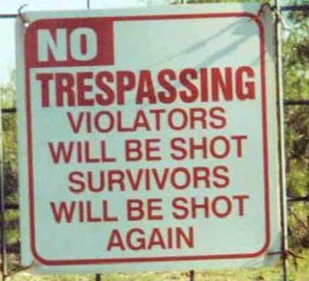
MACHINE GUN THEORY
AS OF 10 OCT 04
CDC

Slide 2
References
Number | Title | Date | Para no.
FM 3-22.68 | Crew-Served Machine Guns, 5.56-mm and 7.62-mm | Jul 2006
FM 5-19 | Risk Management | Aug 2006
TC 3-34.489 | The Soldier and the Environment | May 2001

Slide 3
TERMINAL LEARNING OBJECTIVE
Action: Familiarize with Machine Gun Theory.
Conditions: Given FM 3-22.68, student handouts, reading assignments, and an instructor in a classroom with training materials.
Standard: Familiarize with Machine Gun Theory IAW FM 3-22.68, the TEWT, and FLX I / II.

Slide 4
Administrative Notes
SAFETY CONSIDERATIONS NONE
RISK ASSESSMENT LOW
ENVIRON. CONSIDERATIONS NONE
EVALUATION NONE

Slide 5
INTRODUCTION
“If any single event can be said to have
transformed the history of warfare,
it was the perfection of the true automatic
machine-gun by Hiram Maxim in 1885.”
“Of all the hideous weapons of war produced
in the 20th Century, none has extracted
a more dreadful toll of human life than the
machine-gun.”

Slide 6
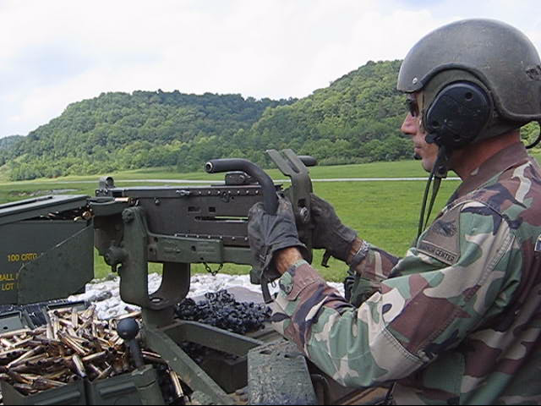

Slide 7
“THE MACHINE GUN WILL NEVER REPLACE THE HORSE AS AN INSTRUMENT OF WAR”.
SIR DOUGLAS HAIG,
COMMANDER-IN-CHIEF BRITISH EXPEDITIONARY FORCES
DECEMBER 1915
HISTORY
Think this guy feels like an idiot?

Slide 8
WORLD WAR I
01 JULY 1916
THE SOMME
ON THE FIRST DAY OF THE ALLIED SOMME OFFENSIVE, 19,000 BRITISH AND COMMONWEALTH SOLDIERS WERE KILLED, AND A FURTHER 38,000 WOUNDED BY GERMAN MACHINE GUN FIRE.
HISTORY
But why? How were soldiers employed then? What were the tactics and mentality of the time? What was the dominant form of warfare…the Defense or Offense?
Notes:
Have a candidate read the slide and then prompt them on the questions at the bottom just for discussion purposes. Soldiers were mostly employed in 12 man squads without organic machine guns. It was thought that courage and fearlessness could overcome an type of weapon created by man. Therefore, you have soldiers who believe that courage will carry them through the battle who are charging on the offense, which at the time was the weaker form of maneuver (the dominant form of warfare was the Defense up until WWII). It was a clear recipe for disaster.

Slide 9
HISTORY
WORLD WAR I
From 1914 to 1918, at least 9 million soldiers were killed. An
additional 12.5 million soldiers were wounded for a total of 22
million casualties. Conservative estimates say that 25%, or
5.5 million soldiers, were a result of machine-gun fire.
So what resulted from this? What did the Allies and Axis Powers learn? What weapons were developed as a counter-measure to the machine-gun?
Notes:
The machine gun greatly increased casualties and the war came to a stalemate. The Allies and Axis Powers then began to heavily fund Research & Development in an attempt to achieve decisive warfare again. New inventions such as poison gas and flame throwers emerged, but the TANK was the weapon specifically developed as a counter-measure to the machine gun. The TANK was first developed to not fight other tanks, but to break through No-Man’s Land and provide protection for the Infantry against the machine gun.

Slide 10
TODAY
Today there are two machine-guns at the Infantry Platoon level. Why do we have both a 5.56mm machine-gun and a 7.62mm machine-gun? Why don’t we convert to just one caliber? What are the pros and cons of each?
Notes:
This slide is intended to get the candidates thinking about the machine guns of today. The two types of machine guns organic to a Light Infantry Platoon are the M240 MG (7.62mm) and the M249 SAW (5.56mm). We have two types of calibers because 7.62mm has more penetrating power but weighs more, whereas 5.56mm is lighter but doesn’t penetrate as far as 7.62mm.

Slide 11
ENABLING LEARNING OBJECTIVE A
Action: Describe the considerations of machine-gun fire.
Conditions: Given FMs, student handouts, reading assignments, and an instructor in a classroom with training materials.
Standard: Correctly perform task standards IAW ARTEP 7-8 MTP in order to perform an over- watch/support by fire during the TEWT or FLX week of training.

Slide 12
As the Platoon Leader, you
are responsible for the proper employment and training of the platoon’s machine-gun crews!
What weapons are organic to an Infantry Platoon?
Notes:
Ask the candidates what the organic weapons are in an Infantry Platoon. Many won’t be able to name all of them. The answer to this question is on Slide 11.

Slide 13
ORGANIC WEAPONS
M249 SAW (5.56mm)
M240B MG (7.62mm)
M203 Grenade Launcher (40mm)
M4 Carbine (5.56mm)
M16A2 “Long Rifle or Musket”
M14 (7.62mm)
AT-4 (84mm)
Javellin

Slide 14
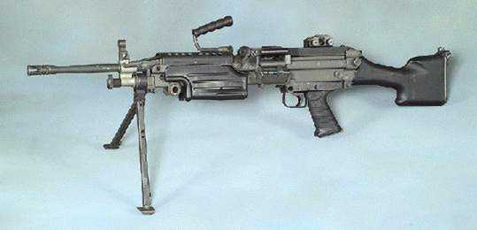
ORGANIC WEAPONS
M249 SAW - 5.56mm
Squad Automatic Weapon
(Light Machine-gun)
Notes:
Describe the 100-round Assault pouch and the 200-round plastic magazine. Also, point out the fact that you can take a 30-round magazine and place it in the magazine weld if no belt ammunition is available.

Slide 15
GENERAL DATA – M249
CALIBER: 5.56mm
MAXIMUM RANGE: 3600 m
MAXIMUM EFFECTIVE RANGE:
  POINT TARGETS 600 m
  AREA TARGETS 800 m
  SUPPRESSION 1000 m
RATES OF FIRE:
SUSTAINED: 50rpm
RAPID: 100 rpm
CYCLIC: 650-850 rpm
Notes:
NO NOTES REQUIRED

Slide 16
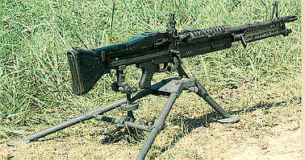
ORGANIC WEAPONS
M60 7.62mm
Medium Machine-gun “The PIG”
(John Rambo’s WEAPON OF CHOICE)
Notes:
This is a picture of an M60 Machine Gun so that those who do not know what it looks like will be able to identify it in the future.

Slide 17
GENERAL DATA – M60
CALIBER: 7.62mm
MAXIMUM RANGE: 3725 m
MAXIMUM EFFECTIVE RANGE: 1,100m
GRAZING FIRE: 600m
TRACER BURN OUT: 900m
RATES OF FIRE:
SUSTAINED: 100 rpm
RAPID: 200 rpm
CYCLIC: 550 rpm
Notes:
NO NOTES REQUIRED

Slide 18
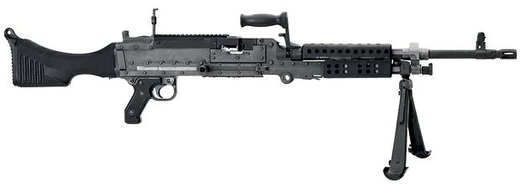
ORGANIC WEAPONS
M240 7.62mm
Medium Machine-gun
Notes:
The slide visually shows the M240 MG. One important thing to ask the candidates is how to identify the M240 vs. the M60 (i.e., the large carrying handle on top, the awkwardly shaped butt stock, and Weaver Rail System on the heat shields).

Slide 19
GENERAL DATA – M240B
CALIBER: 7.62mm
MAXIMUM RANGE: 3725 m
MAXIMUM EFFECTIVE RANGE: 1,100m
GRAZING FIRE: 600m
TRACER BURN OUT: 900m
RATES OF FIRE:
SUSTAINED: 100 rpm
RAPID: 200 rpm
CYCLIC: 650-950 rpm
Notes:
NO NOTES REQUIRED

Slide 20
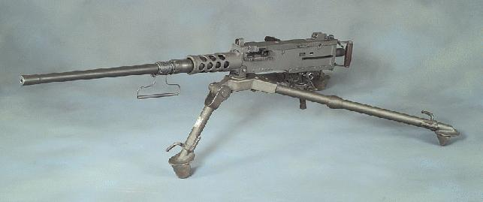
ADDITIONAL MGs
Browning M2 HB
.50 Caliber Heavy Machine-gun
Notes:
Although the M2 Heavy Barrel .50 Caliber MG is not organic to an Infantry Platoon, candidates should still be able to identify it and know its capabilities. These weapons are often mounted on HMMWVs, the Stryker Vehicle, and FMTVs (5-ton Truck), which could be in support of any of the candidates in any branch on today’s battlefield.

Slide 21
GENERAL DATA – M2 HB
CALIBER: .50 cal (12.7mm)
MAXIMUM RANGE: 6764 m (4.22 miles)
MAXIMUM EFFECTIVE RANGE:
  POINT TARGETS: 1500 m (Single Shot)
  AREA TARGETS: 1830 m
RATES OF FIRE:
SINGLE SHOT or CYCLIC: 450-550 rpm
TYPES OF AMMO:
BALL INCENDIARY
TRACER AP (ARMOR PIERCING)
DUMMY API (ARMOR PIERCING INCENDIARY)
BLANK APIT (ARMOR PIERCING INCENDIARY TRACER)
Notes:
Discuss the differences in ammunition on the .50 cal. Explain what ball, tracer, AP, and AP Incendiary munitions are used for.

Slide 22
ENABLING LEARNING OBJECTIVE B
Action: Describe & understand machine-gun terminology.
Conditions: Given FMs, student handouts, reading assignments, and an instructor in a classroom with training materials.
Standard: Correctly perform task standards IAW ARTEP 7-8 MTP in order to perform an over- watch/support by fire during the TEWT or FLX week.

Slide 23
MACHINE-GUN TERMINOLOGY
LINE OF SIGHT
BURST OF FIRE
TRAJECTORY
MAXIMUM ORDINATE
CONE OF FIRE
BEATEN ZONE
DANGEROUS SPACE
DANGEROUS ZONE
DEAD SPACE
Notes:
LINE OF SIGHT. Line of sight is an imaginary line drawn from the firer’s eye through the sights to the point of aim.
BURST OF FIRE. A burst of fire is a number of successive rounds fired with the same elevation and point of aim when the trigger is held to the rear. (The number of rounds in a burst can vary depending on the type of fire employed).
TRAJECTORY. Trajectory is the curved path a round takes during its flight. The trajectory of a round is affected by air resistance and gravity.
MAXIMUM ORDINATE. The Maximum Ordinate is the highest point above the line of sight to which a projectile rises during its flight. The maximum ordinate occurs approximately 2/3 of the way along the trajectory of the projectile. As the range increases so does the height of the maximum ordinate.
CONE OF FIRE. The group of trajectories resulting from a burst of fire is termed the cone of fire. As the burst of fire strikes a vertical target, the rounds will form a pattern, oval in shape, with the density of shots decreasing towards the edges.
BEATEN ZONE. The pattern formed when the cone of fire strikes the ground is termed the beaten zone. It is oval or cigar shaped and the density of rounds decreases towards the edges. Because of dispersion only that part of the beaten zone in which 85% of the rounds fall is considered the effective beaten zone).
DANGEROUS SPACE Dangerous space occurs between the muzzle of the machine gun and the point of first graze. The extent of dangerous space will depend on the following:
(1) the range,
(2) the height of the weapon above the target,
(3) the height of the target engaged,
(4) the shape of the ground, and
(5) the flatness of the trajectory.
DANGEROUS ZONE The dangerous zone is that area covered by the dangerous space and the beaten zone. For fire to be effective, the target must be included in the dangerous zone.
DEAD SPACE Any fold or depression in the ground that prevents a target from being engaged from a fixed position is termed dead space.

Slide 24
MACHINE-GUN TERMINOLOGY
LINE OF SIGHT
An imaginary line, from the firer’s eye,
through the sights, to the point of aim on the
target.

Slide 25
MACHINE-GUN TERMINOLOGY
BURST OF FIRE
A burst of fire is a number of successive rounds fired
with the same elevation and point of aim when the
trigger is held to the rear. The number of rounds in a
burst will vary, depending on the type of fire
employed.

Slide 26
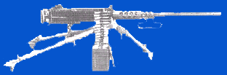
MACHINE-GUN TERMINOLOGY
TRAJECTORY
Trajectory is the curved path a round takes during its flight. The trajectory of a round is affected by air resistance and gravity.

Slide 27
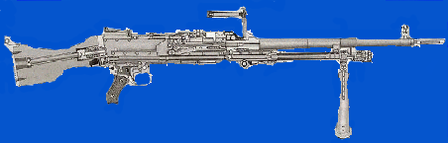
MACHINE-GUN TERMINOLOGY
MAXIMUM ORDINATE
Maximum ordinate is the highest point above the line of sight to which a projectile rises during its flight. The maximum ordinate occurs approximately 2/3 of the way along the trajectory of the projectile.
AS THE RANGE INCREASES, SO DOES THE HEIGHT OF THE MAXIMUM ORDINATE.
MAXIMUM ORDINATE

Slide 28
MACHINEGUN TERMINOLOGY
CONE OF FIRE
The group of trajectories resulting from a burst of fire is termed the cone of fire. When a burst of fire strikes a vertical target, the rounds will form a pattern, oval in shape, with the density of shots decreasing towards the edges.
CONE OF FIRE

Slide 29
MACHINEGUN TERMINOLOGY
BEATEN ZONE
THE PATTERN FORMED WHEN THE CONE OF FIRE STRIKES THE GROUND, IS TERMED THE BEATEN ZONE. IT IS OVAL OR CIGAR SHAPED AND THE DENSITY OF ROUNDS DECREASES TOWARDS THE EDGES. ONLY THAT PART OF THE BEATEN ZONE IN WHICH 85% OF THE ROUNDS FALL IS CONSIDERED THE EFFECTIVE BEATEN ZONE.
BEATEN ZONE

Slide 30
MACHINE-GUN TERMINOLOGY
DANGEROUS SPACE
DANGEROUS SPACE OCCURS BETWEEN THE MUZZLE OF THE MACHINE GUN AND THE POINT WHERE THE LOWEST ROUND IN THE BEATEN ZONE STRIKES THE GROUND.

Slide 31
MACHINE-GUN TERMINOLOGY
DANGEROUS ZONE
THE DANGEROUS ZONE IS THAT AREA COVERED BY THE DANGEROUS SPACE AND THE BEATEN ZONE. FOR THE FIRE TO BE EFFECTIVE, THE TARGET MUST BE INCLUDED IN THE DANGEROUS ZONE.
DANGEROUS ZONE

Slide 32
DEAD SPACE
ANY FOLD OR DEPRESSION IN THE GROUND
THAT PREVENTS A TARGET FROM BEING ENGAGED
FROM A FIXED POSITION IS TERMED DEAD SPACE.
DEAD
SPACE
Notes:
Ask the candidates what they think the definition of Dead Space is, and then have one of them read the doctrinal definition and the picture for clarity. What weapons are typically emplaced to cover deadspace? Claymores, M203 Grenade Launcher, the Mk 19 Automatic Grenade Launcher, mortars, etc.

Slide 33
ENABLING LEARNING OBJECTIVE C
ACTION: Describe the effects of range & terrain on the Beaten Zone.
CONDITIONS: Given FMs, student handouts, reading assignments, and an instructor in a classroom with training materials.
STANDARD: Correctly perform task standards IAW ARTEP 7-8 MTP in order to perform an over-watch/support by fire during the TEWT or FLX week.

Slide 34
The effects of Range on the Beaten Zone

Slide 35
RANGE EFFECTS
AS RANGE INCREASES…………………………………..
M240B
RANGE: 500m 1 X 110 m
RANGE: 1000m 2 X 75 m
RANGE: 1500m 3 X 55 m
RANGE: 2000m 4 X 50 m
(IT Vol 4, Pam 7, M60, 1980, Australia & RAInf Corps Trg. Notes Vol 2 Pam 6, DFSW Pl. 1995, Australia)
Notes:
Discuss the fact that as range increases, the elevation on the gun must increase, producing a greater angle between the trajectory of the round and the ground, thus resulting in a normal ellipse. Likewise, as range decreases, so does the elevation on the gun, producing less of an angle between the trajectory of the round and the ground, thus resulting in a more thin and elongated ellipse.

Slide 36
The effects of the Ground on the Beaten Zone

Slide 37
GROUND EFFECTS
STEEP HILLSIDE
RISING SLOPE
LEVEL GROUND
CONFORMING GROUND
Notes:
The Effects Of Ground On The Beaten Zone
9. Ground will have a marked effect on the length of the beaten zone. A cone of fire striking a steep hillside will cover a very small area of ground and produce a small beaten zone.
The same cone of fire striking a more gentle slope will produce a slightly larger beaten zone. On level ground the beaten zone will be still larger. The largest beaten zone will result where the fall of ground conforms to the trajectory of the round.

Slide 38
FACTORS AFFECTING
A MG BURST
        The Gun & the Ammunition
        The Firer’s Vision of the Target
        Air Disturbances & Weather
Notes:
Factors That Effect The Burst Of Fire
5. When a burst is fired from a machine gun , no round follows the exact same path. The contributing factors that effect the flight of each round are:
a. THE GUN Regardless of which firing position the gun is fired from, the gun will move while firing bursts. This is because the MG is fired from the open bolt position and when the trigger is squeezed the operating group moves forward with the top locking lug on the bolt stripping the round out of the link belt and forcing the round forward and down into the chamber. The bolt is then locked in the chamber by the clockwise rotation of the bolt. After the round is fired, expanding gasses are forced onto the gas piston to move the operating rod to the rear, at the same time the bolt unlocks from the chamber and is forced to the rear. This continual internal movement, will cause vibrations which cause each round to travel on a separate path.
b. AMMUNITION Although modern day ammunition is very good, it does vary slightly in metal composition and actual make up. The condition in which the ammunition is in when it is fired EG:- wet, dirty, oily etc. will influence the flight of a round.
c. THE FIRER The firer is influenced by the vibration of the gun, and is unable to maintain the same sight picture and firing position.
d. AIR DISTURBANCES The round can pass through hot or cold air disturbances which will vary the flight paths of the rounds. Gusts of wind will also cause the round to travel on separate paths.
e. CLARITY OF TARGET The firers sight picture will also differ if the target is obscured by smoke or dust. The differing sight picture when firing the gun will cause rounds to travel on varying paths.
6. Even if the gun were placed in a weapon clamp and fired, due to some of the above factors the rounds would not follow the same path.

Slide 39
CLASSES OF MG FIRE
Machine-guns produce 2 Classes of Fire
with respect to the Ground:
Grazing Fire or Plunging Fire
Range and Terrain determine the Beaten
Zone.
Notes:
Types Of Fire
10. Machine guns produce two types of fire. It is classed as either Grazing fire or Plunging fire. The two factors that effect the type of fire produced by a gun are Range and Ground.

Slide 40
GRAZING FIRE
Grazing fire is obtained when firing over level or uniformly sloping terrain, where the center of the cone of fire does not rise more than 1 meter above the ground. This is approximately out to 600m. The dangerous zone for this type of fire extends from the muzzle of the gun out to where the farthest round in the beaten zone strikes the ground.
BEATEN ZONE
Notes:
Types Of Fire
10. Machine guns produce two types of fire. It is classed as either Grazing fire or Plunging fire. The two factors that effect the type of fire produced by a gun are Range and Ground.
a. GRAZING FIRE Grazing fire is obtained when firing over flat ground, at ranges where the culminating point of the round does not rise above the height of a standing man (1.8m), this is approximately out to 600m. The dangerous zone, employing this type of fire, extends from the muzzle of the weapon out to where
the last round in the beaten zone strikes the ground.
b. PLUNGING FIRE Plunging fire is achieved when the dangerous zone is practically confined to the beaten zone. It is obtained when firing at very long
ranges, from high ground into low ground or into abruptly rising ground.

Slide 41
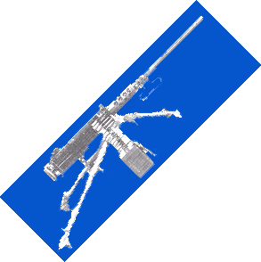
PLUNGING FIRE
PLUNGING FIRE IS ACHIEVED WHEN THE DANGEROUS ZONE IS PRACTICALLY CONFINED TO THE BEATEN ZONE. IT IS OBTAINED WHEN FIRING AT VERY LONG RANGES, FROM HIGH GROUND INTO LOW GROUND OR INTO ABRUPTLY RISING GROUND.
Notes:
Historically, plunging fire compared to grazing fire has not been achieved often in woodland terrain. In Urban Operations, however, due to the presence of buildings and other high-rise structures, plunging fire is much more common. It is therefore important that the candidates understand and know its definition.

Slide 42
Classes of Fire with Respect to the Target

Slide 43
CLASSES OF FIRE WITH RESPECT TO THE TARGET
FRONTAL FIRE
Occurs when the long axis of the beaten zone is perpendicular to the front of the target.
Notes:
a. ENFILADE FIRE Enfilade fire is the application of the long axis of the beaten zone to the long axis of the target.
b. OBLIQUE FIRE Oblique fire is fire delivered at an angle, where the length of the beaten zone is applied to a proportion of the target.
c. FRONTAL FIRE Frontal fire is fire delivered at right angles to the length of the target.

Slide 44
FRONTAL FIRE

Slide 45
CLASSES OF FIRE WITH RESPECT TO THE TARGET
FLANKING FIRE:
Fire that is delivered directly against the flank of the target.
Notes:
a. ENFILADE FIRE Enfilade fire is the application of the long axis of the beaten zone to the long axis of the target.
b. OBLIQUE FIRE Oblique fire is fire delivered at an angle, where the length of the beaten zone is applied to a proportion of the target.
c. FRONTAL FIRE Frontal fire is fire delivered at right angles to the length of the target.

Slide 46
FLANKING FIRE

Slide 47
CLASSES OF FIRE WITH RESPECT TO THE TARGET
OBLIQUE FIRE:
When the long axis of the beaten zone is at an angle other than a right angle to the front of the target.
Notes:
a. ENFILADE FIRE Enfilade fire is the application of the long axis of the beaten zone to the long axis of the target.
b. OBLIQUE FIRE Oblique fire is fire delivered at an angle, where the length of the beaten zone is applied to a proportion of the target.
c. FRONTAL FIRE Frontal fire is fire delivered at right angles to the length of the target.

Slide 48
OBLIQUE FIRE

Slide 49
CLASSES OF FIRE WITH RESPECT TO THE TARGET
ENFILADING FIRE:
When the long axis of the beaten zone coincides or nearly coincides with the long axis of the target. This type of fire is either frontal or flanking. It is the most desirable type of fire with respect to a target because it makes maximum use of the beaten zone.
Notes:
Ask the candidates what they think the definition of Enfilading Fire is, and then have one of them read the doctrinal definition for clarity. This is a test question, so ensure that the candidates understand that Enfilading Fire is the most desirable because it makes maximum use of the beaten zone (i.e., provides the highest probability for killing an individual located in the beaten zone).

Slide 50
ENFILADING FIRE
FRONTAL
FLANKING

Slide 51
Check on Learning
  What is the maximum effective range for a
  M249 SAW?
  3600m
  What is the maximum effective range for a M60?
3725m
  What is the maximum effective range for a M240B?
3725m

Slide 52
Check on Learning
  What is the maximum effective range for a
  M2 .50cal?
  POINT TARGETS: 1500 m (Single Shot)
  AREA TARGETS: 1830 m
  What is the maximum TOTAL range for a
  M2 .50cal?
  MAXIMUM RANGE: 6764 m (4.22 miles)

